Slide 1


Eride global dev
Closed issues
Open issues
Lsmetrics dev
ErideR dev
Nature paper Comms dev
Other pubs
August and September 2023
Nesi-GRASS compatibility
Latitudinal gradient chats
October
Nesi
Global Mosaic job failed (Nov)
Nature Comms paper accepted
Dec
Brazil
USP, UNESP & Leave
2023
Degrade it to 100 m
Jan
Back from Brazil
Feb
Capital City Complex Systems
Epi Interactive Meeting
April-May
Global One Health
Austria Task Force
May -June
Fingerprint
FYM
Other pubs
July
Chat with David Wilkinson
August
Backups to G: (8TB)
Toy Github repo
August-
Latitude issue
Mosaic issue
2024

Slide 2
Looping over scales in eride
Changing wres of g.region might not be the best strategy because the resampling method is through NN default:
https://grasswiki.osgeo.org/wiki/Computational_region
Compare results when you 1) change in wres through g.region versus 2) loop using resampling (bilinear)

Slide 3
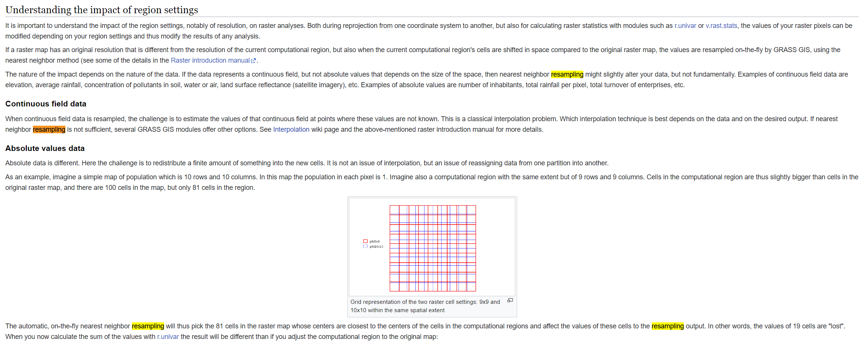
NN on the fly for g.region set up

Slide 4

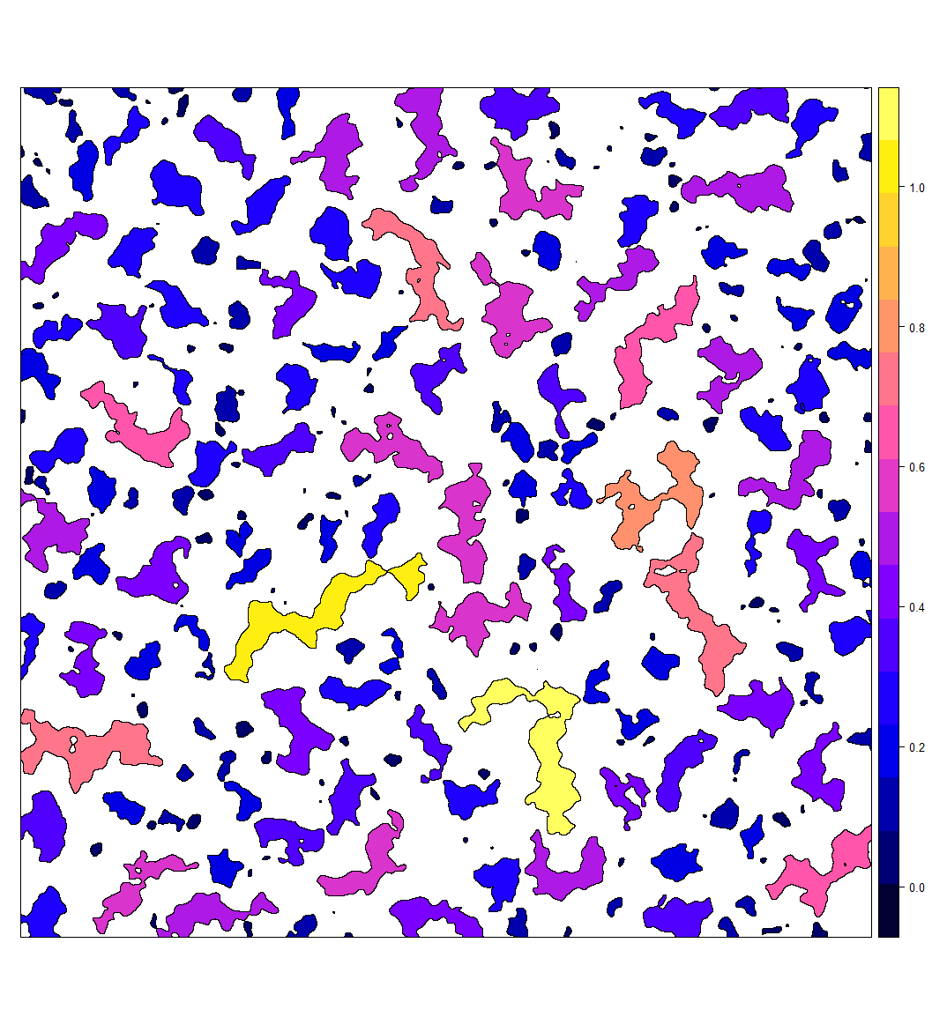

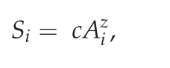
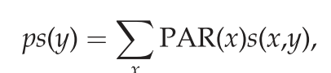
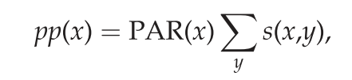
Context: Edges
Hazard
Edge amount
eRIDE
Estimated risk for novel infectious disease emergence: scales linearly with patch biodiversity and patch perimeter
population at risk (PAR) for each pixel: product of the pixel eRIDE and pop density
The pandemic risk following initial spillover depends on subsequent human to human transmission and thus will be driven by pop density and connectivity (Dijkstra’s algorithm).
Biodidiversity
in a forest patch
eRIDE ~
PAR = eRIDE x Pop density
Received
Generated
Notes:
An eRIDE index (sumof the product of number of edge pixels from each patch and their corresponding patch bio- diversities) were calculated within a 20 X 20 moving window for each pixel of these data. The
A division index (number of unique patches), an edge density index (number of edge pixels) and an eRIDE index (sumof the product of number of edge pixels from each patch and their corresponding patch bio- diversities) were calculated within a 20 ? 20 moving window for each pixel of these data. The estimated population at risk (PAR) for each pixel was defined as the product of the pixel eRIDE index and the population density at that location.

Slide 5


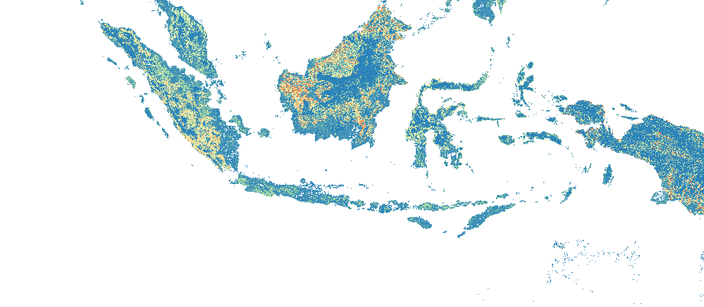
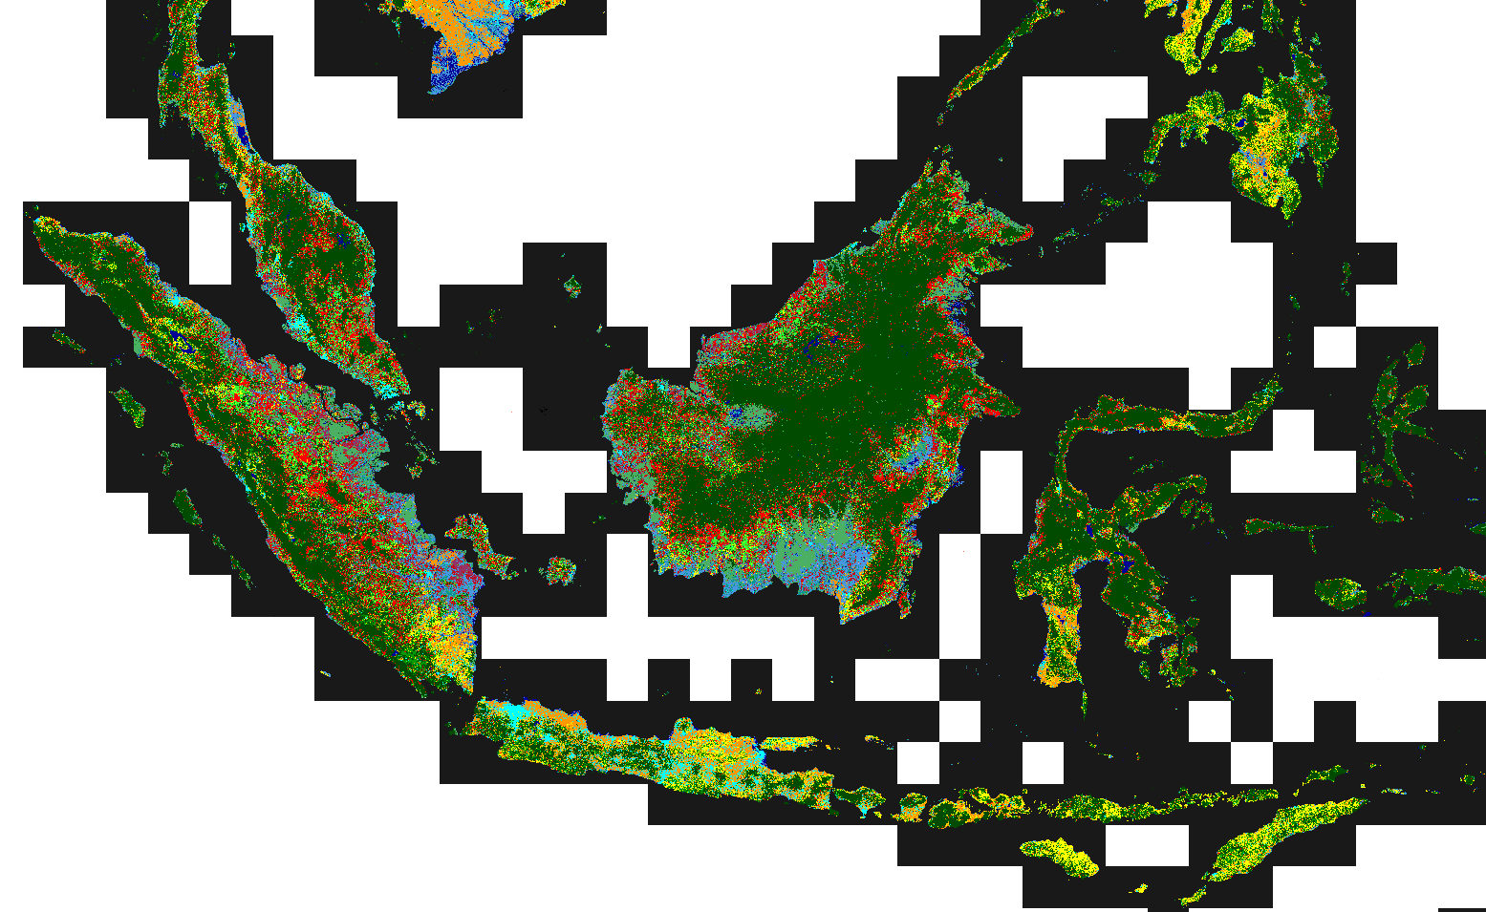
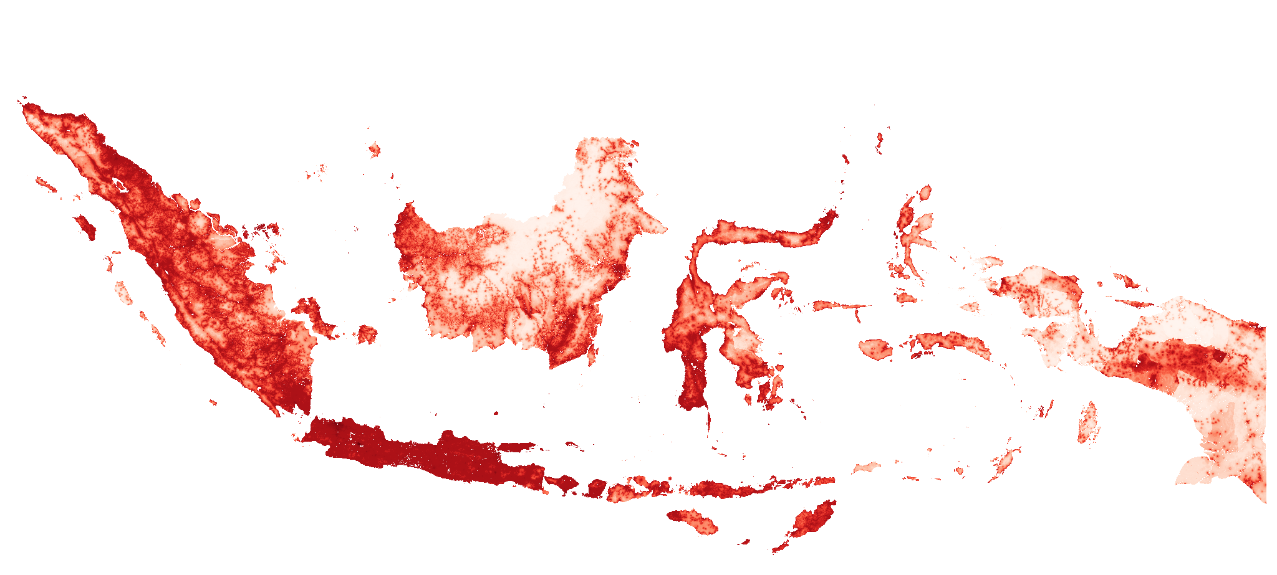
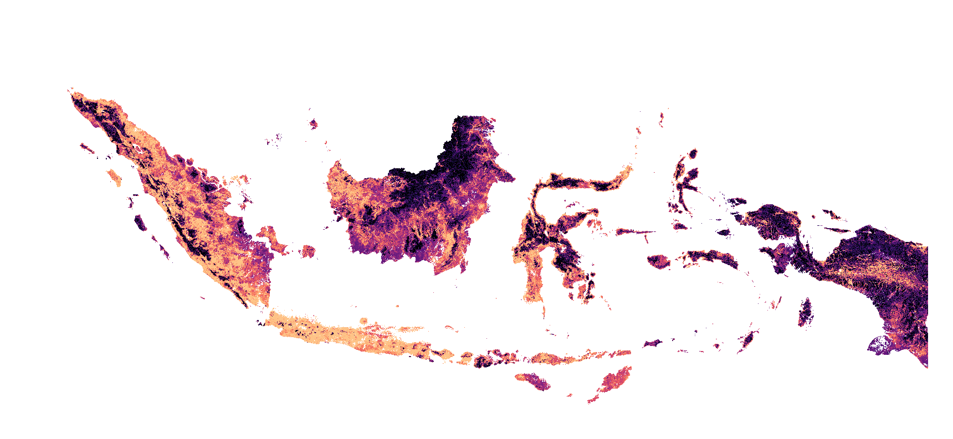
Environment set up
Region set up
eRIDE source function
Region projection
eride_run("rast", "pop")
eRIDE
v.import
execGRASS("g.proj", flags = "c", parameters = list(raster = "rast"))
Init GRASS
Region
resolution
human population
wres <- '100'
land use rast
execGRASS("g.region", parameters = list(raster = “rast"), res=wres)
PAR
EPSG:4326 - WGS 84
Region extent
EPSG:3857 - WGS 84 / Pseudo-Mercator
execGRASS("g.region", parameters = list(raster = "pop")

Slide 6
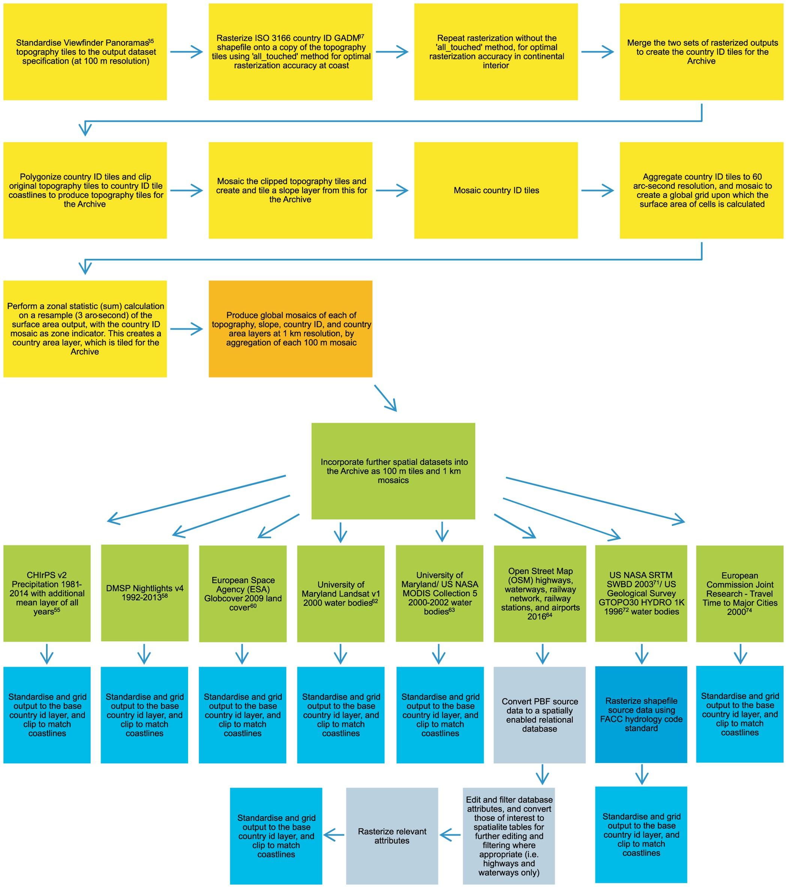
Worldpop generation
https://www.nature.com/articles/sdata20171#Sec24
Otherwise, aggregation techniques in ArcMap are sometimes utilised to downsample particular datasets (from 100 m to 1 km), where deemed to provide greater accuracy than the nearest neighbour resampling method. When downsampling the gridded output, nearest neighbour is best suited to categorical data where there are many values to consider.
Because of that, you could stick with gregion on the fly changes!!! You are of modifying pop afterall!!!!! Because native resolution for pop is 100m!
Notes:
Gridded outputs are produced using suitable resampling or aggregation techniques where applicable, as appropriate to the data type. Resampling is usually employed, and the nearest neighbour technique is applied for spatial consistency and to preserve original data values. Otherwise, aggregation techniques in ArcMap are sometimes utilised to downsample particular datasets (from 100 m to 1 km), where deemed to provide greater accuracy than the nearest neighbour resampling method. When downsampling the gridded output, nearest neighbour is best suited to categorical data where there are many values to consider. However, aggregation offers superior sampling options for some of the continuous data (e.g., topography, slope). This is also the case for categorical data that are binary, or for categorical data where the choice of data value for each aggregated cell is overwhelmingly binary (e.g., the country ID, country area, and water body data). Aggregation can provide superior output when downsampling because the method assesses all of the input cells that are encompassed by the extent of the output cell during the calculation, rather than just one cell at the centre as is the case with the nearest neighbour technique. Further, most aggregation techniques can ignore input pixel values with no data, meaning that output data are not truncated where significant zones of no data exist within an input dataset, an issue that can be particularly important (e.g., water body data, or at coastlines) when the downsample is of an order of magnitude (i.e., 100 m to 1 km).

Slide 7
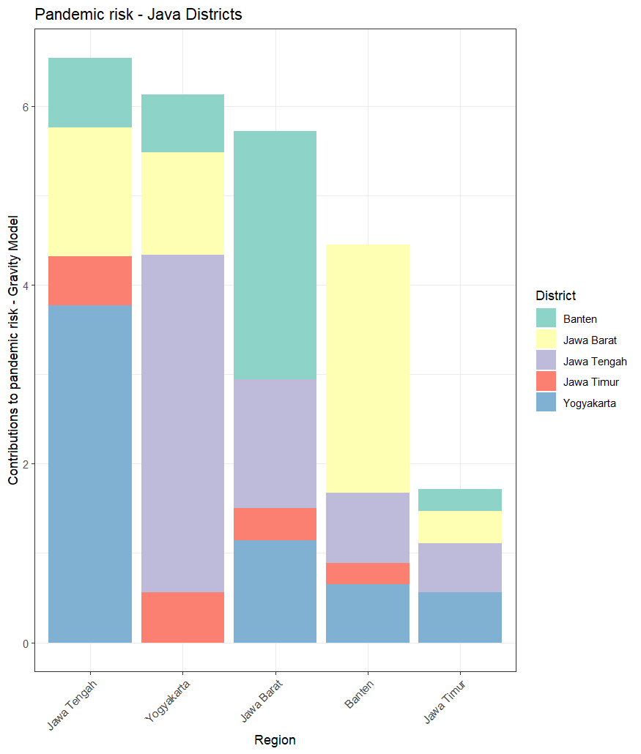
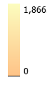
Received pandemic risk
PAR
Pandemic risk
gravity_run(“PAR")
Gravity model

Slide 8
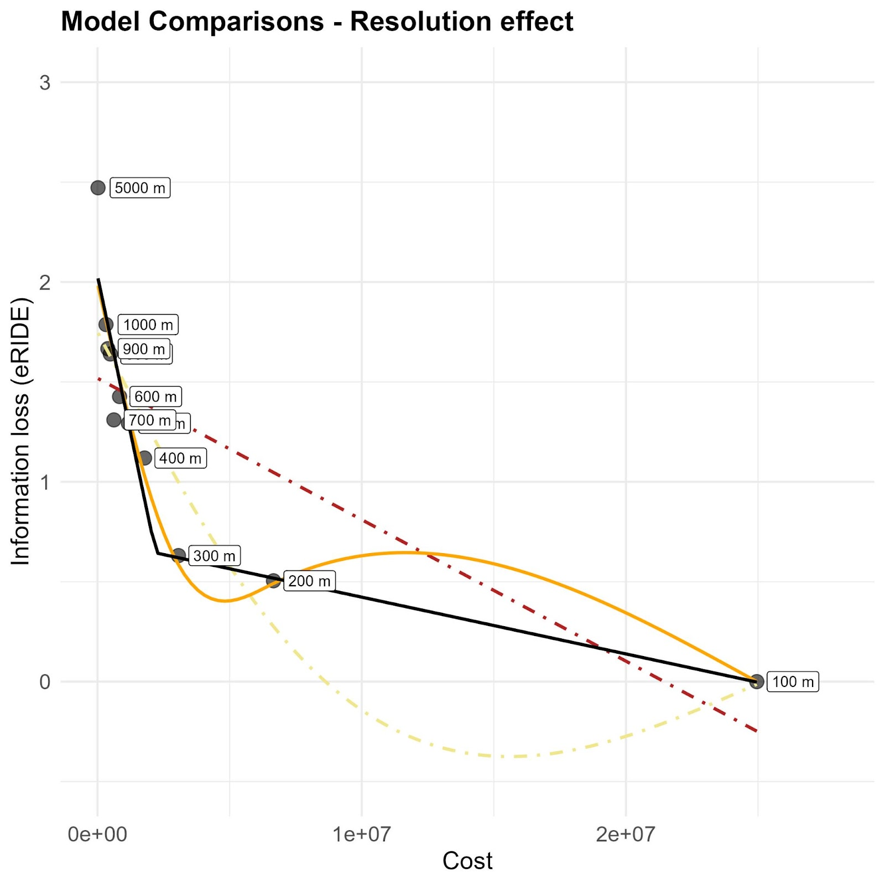
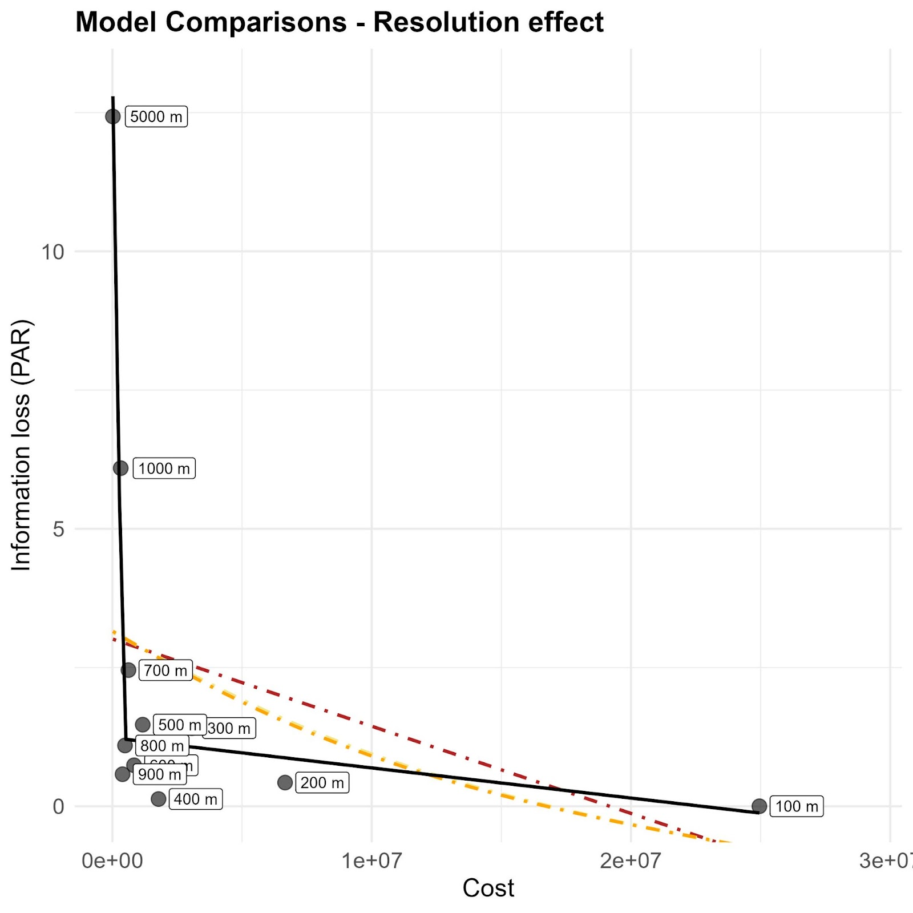
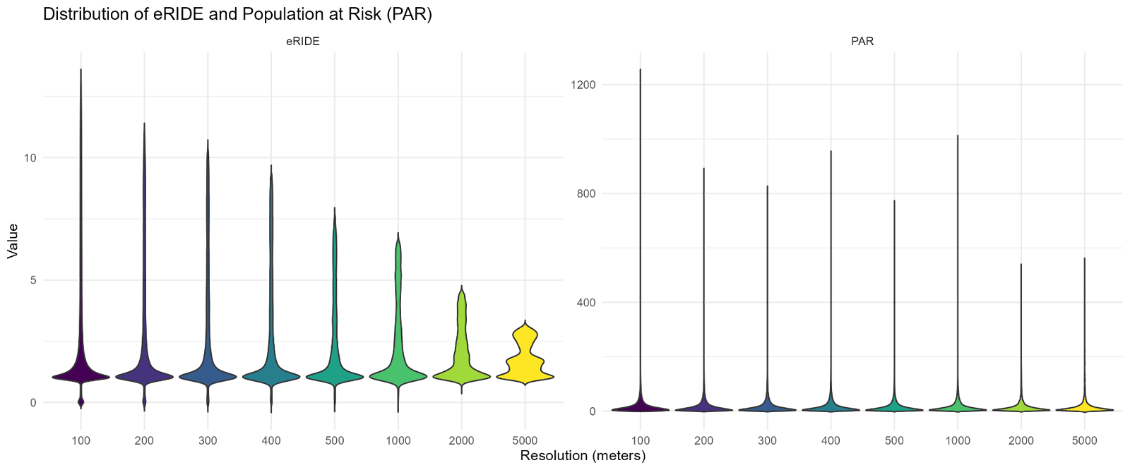
PAR
ERIDE
100 m
How much information is lost?
-Check plateau
-Check pop
5000 m

Slide 9
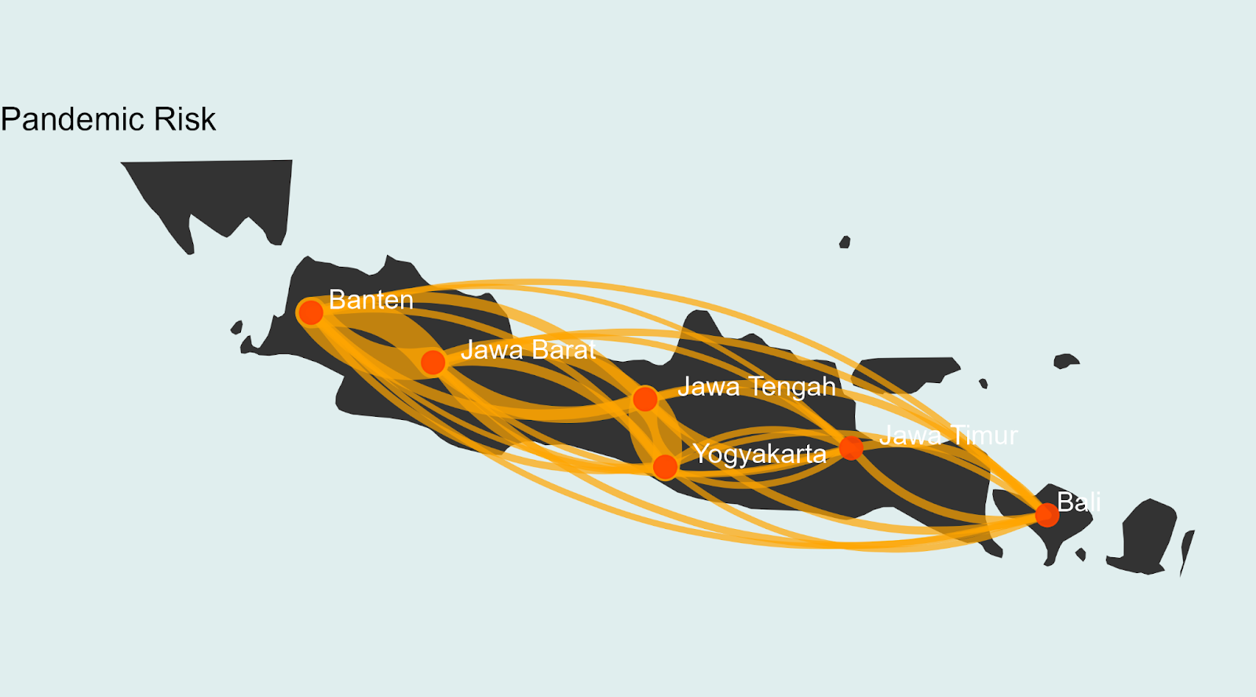
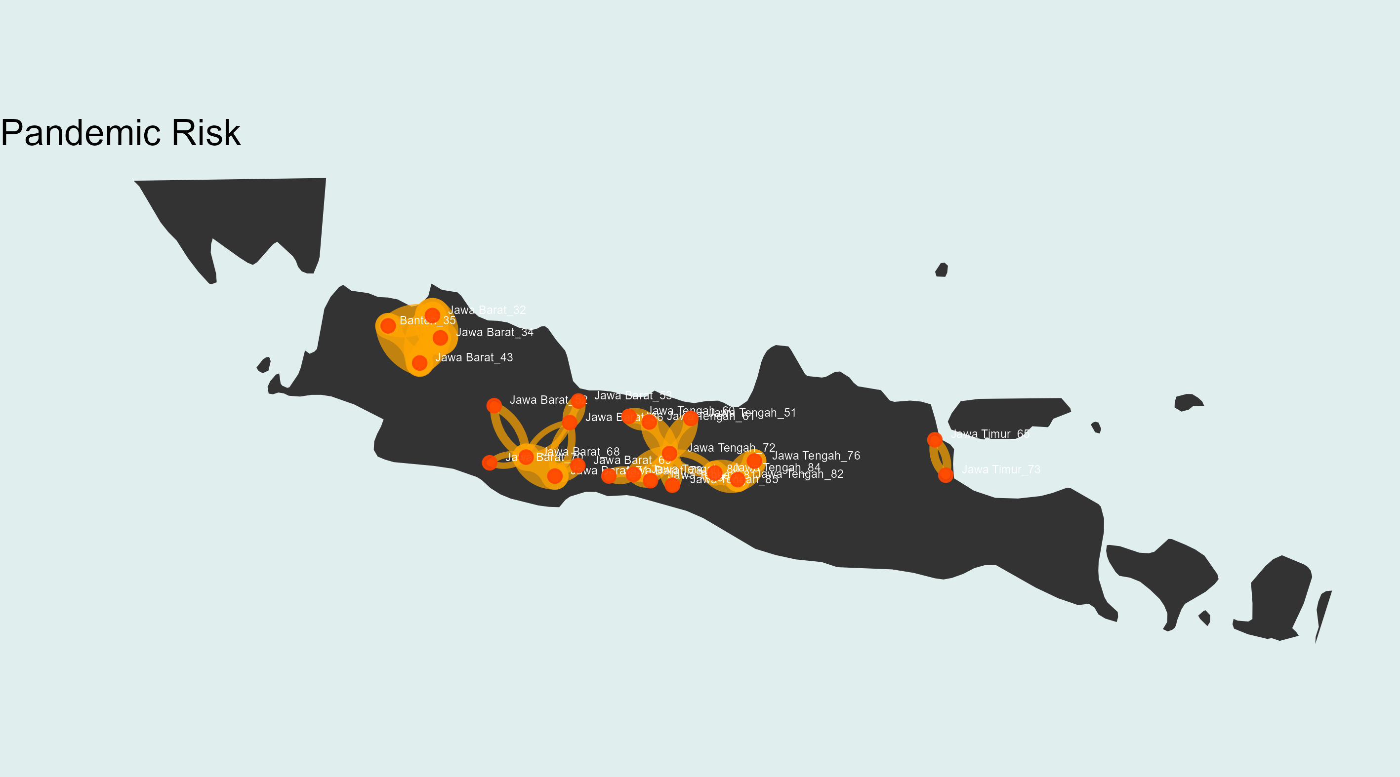
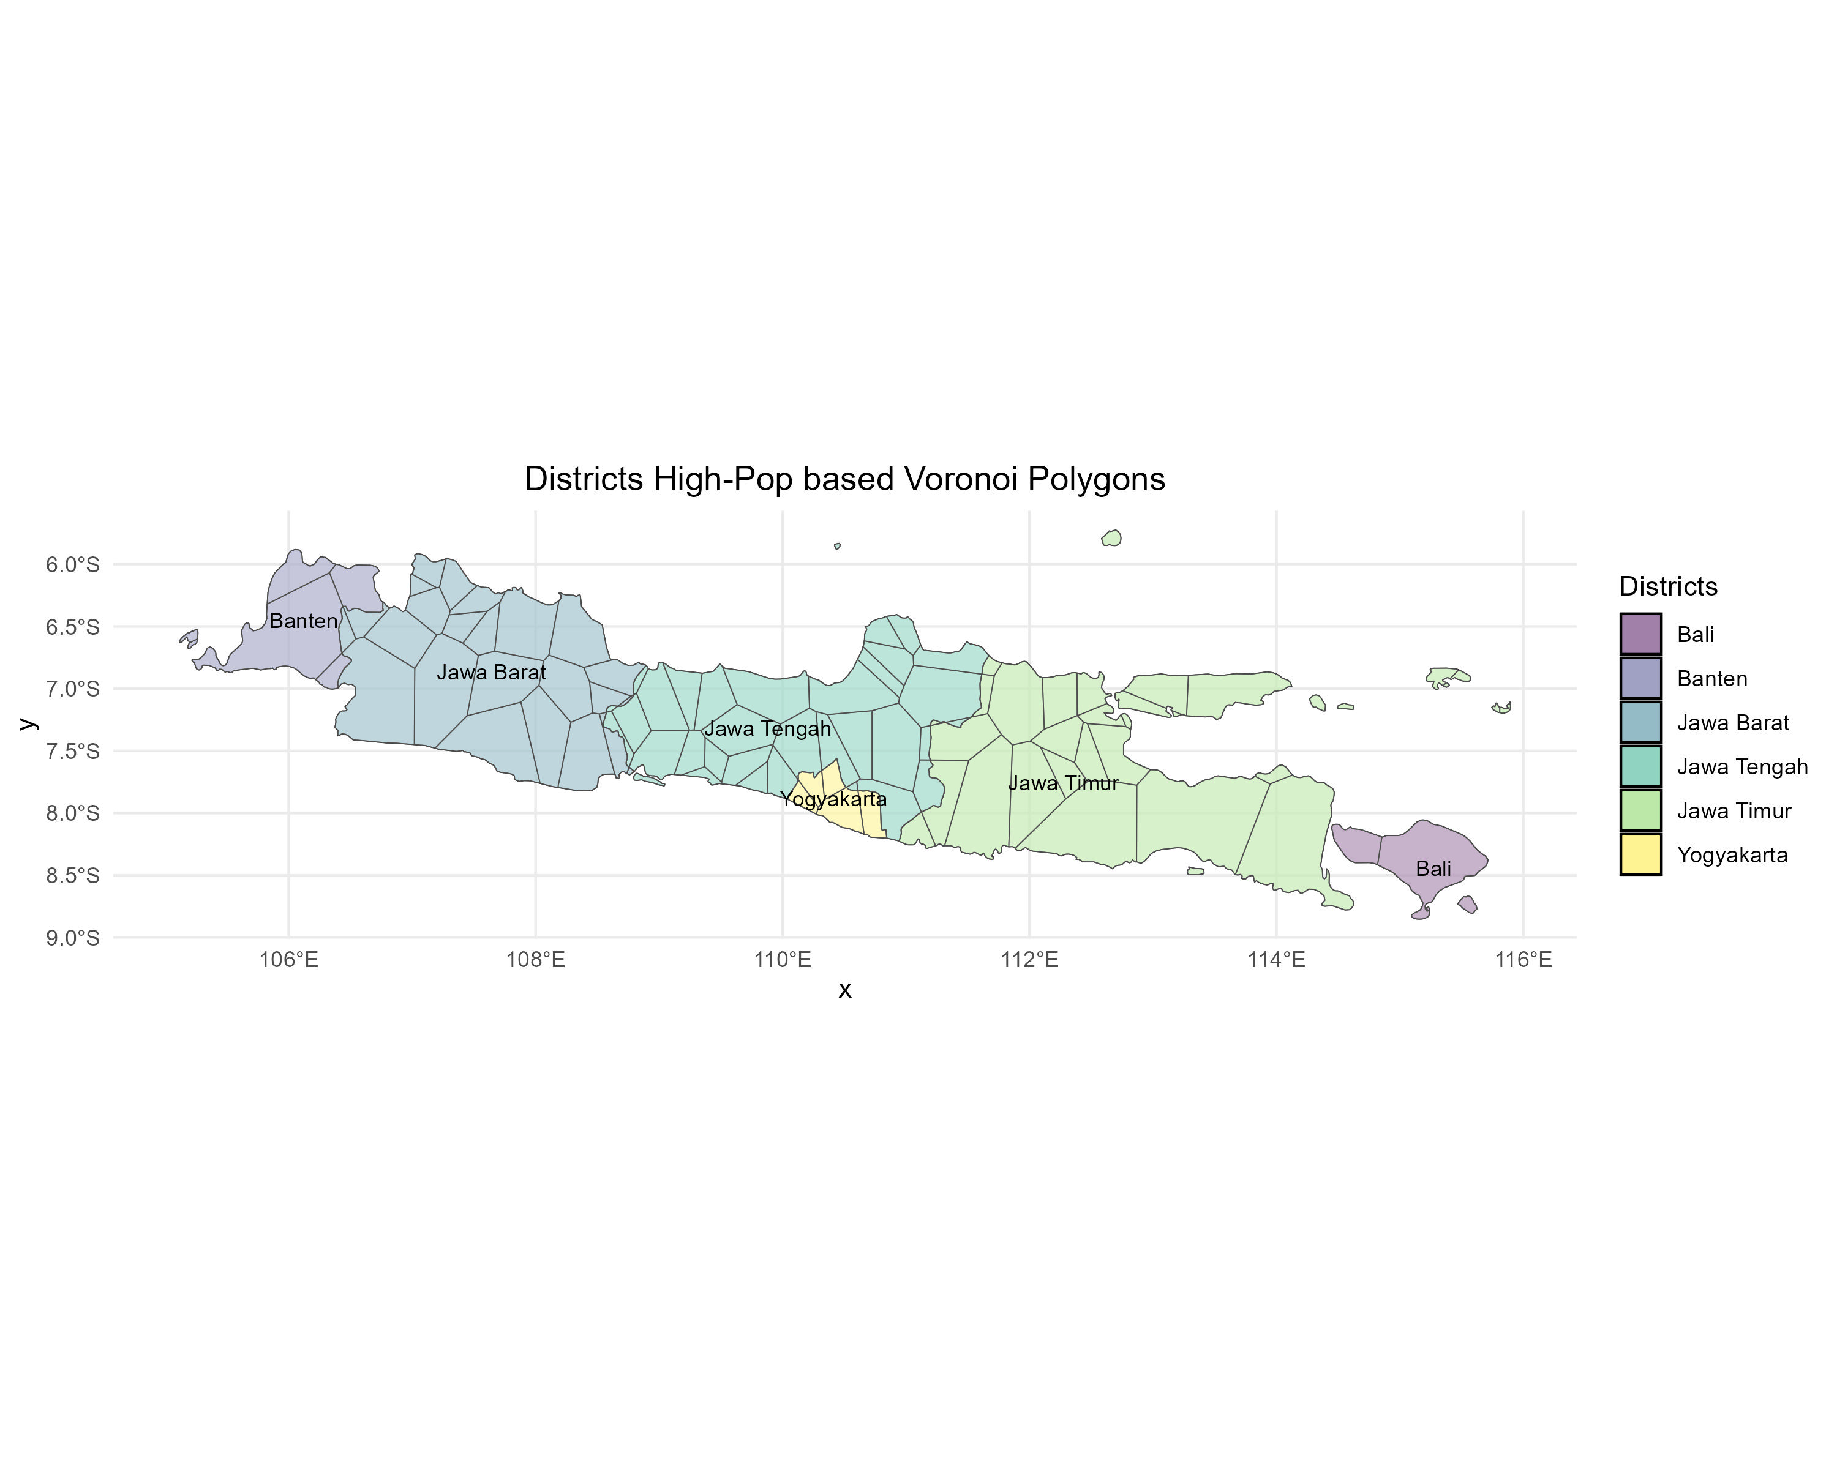
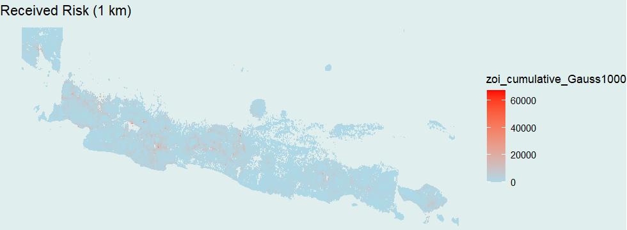
How much complexity is enough to
capture the contributions to overall risk?
District Centroids
Neighborhood rules (island)
-Contiguity
-+ Buffer of reach? (ZOI)
Pop-informed Voronoi forced upon Districts
Pixel-level
connectivity

Slide 10
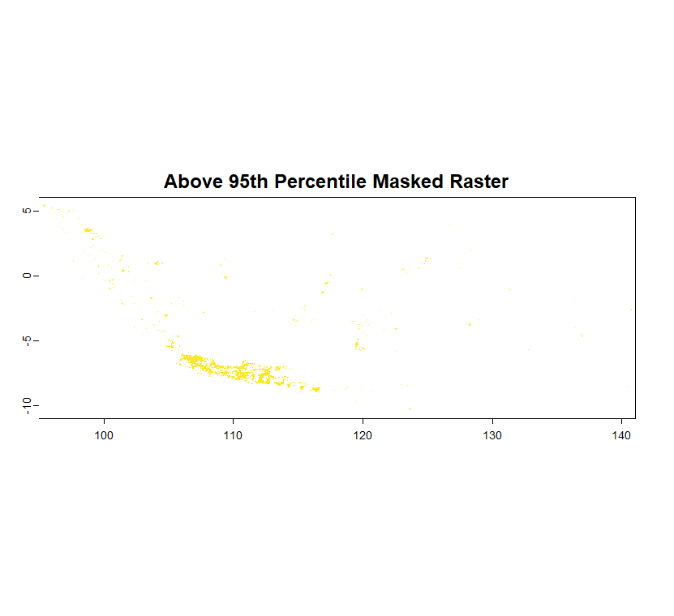

Slide 11
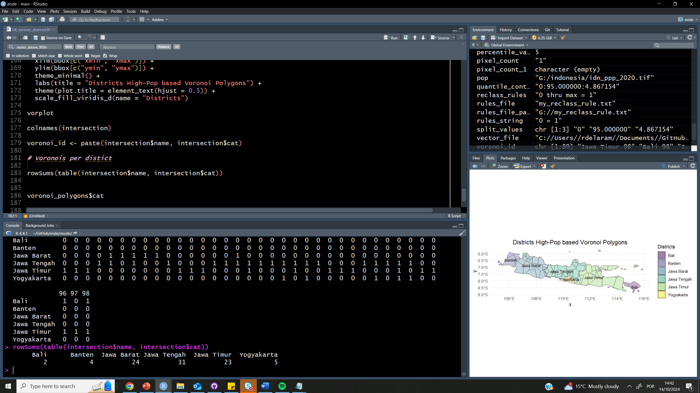

Slide 12
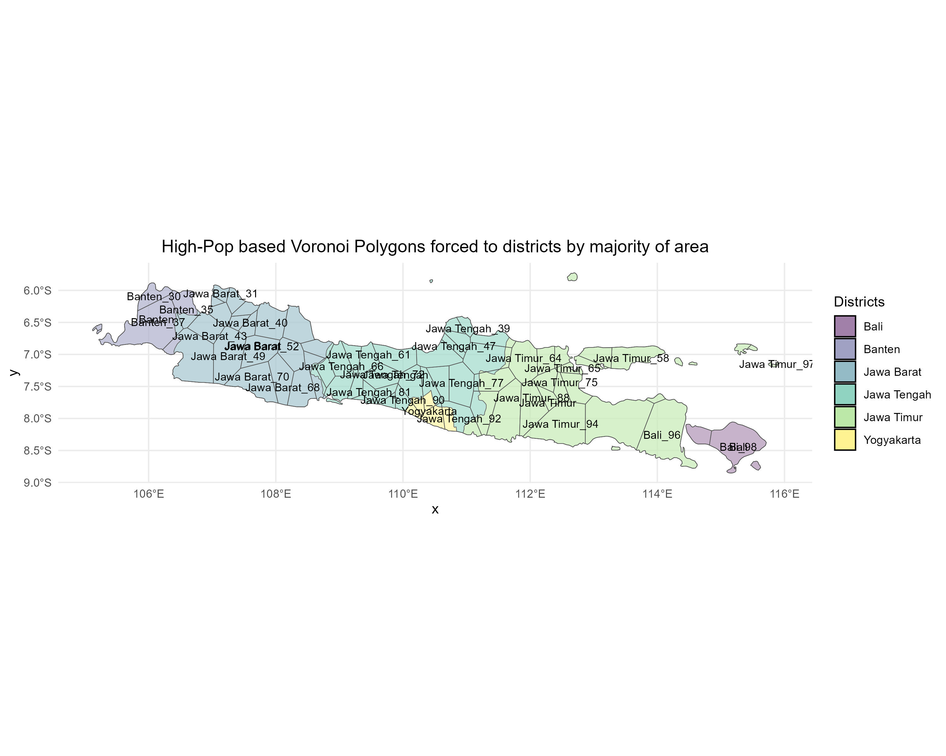

Slide 13
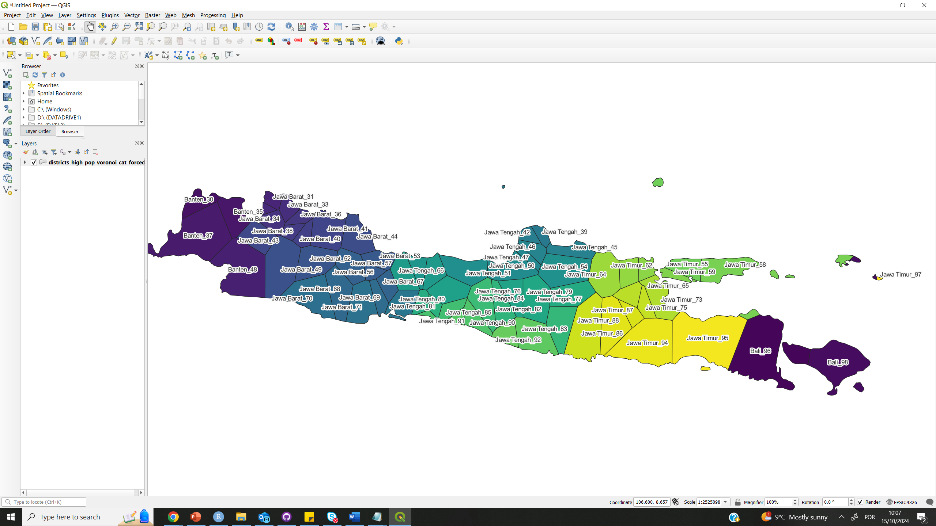
Multi-feature polygon issues, island issues, region attribution by majority issues:

Slide 14
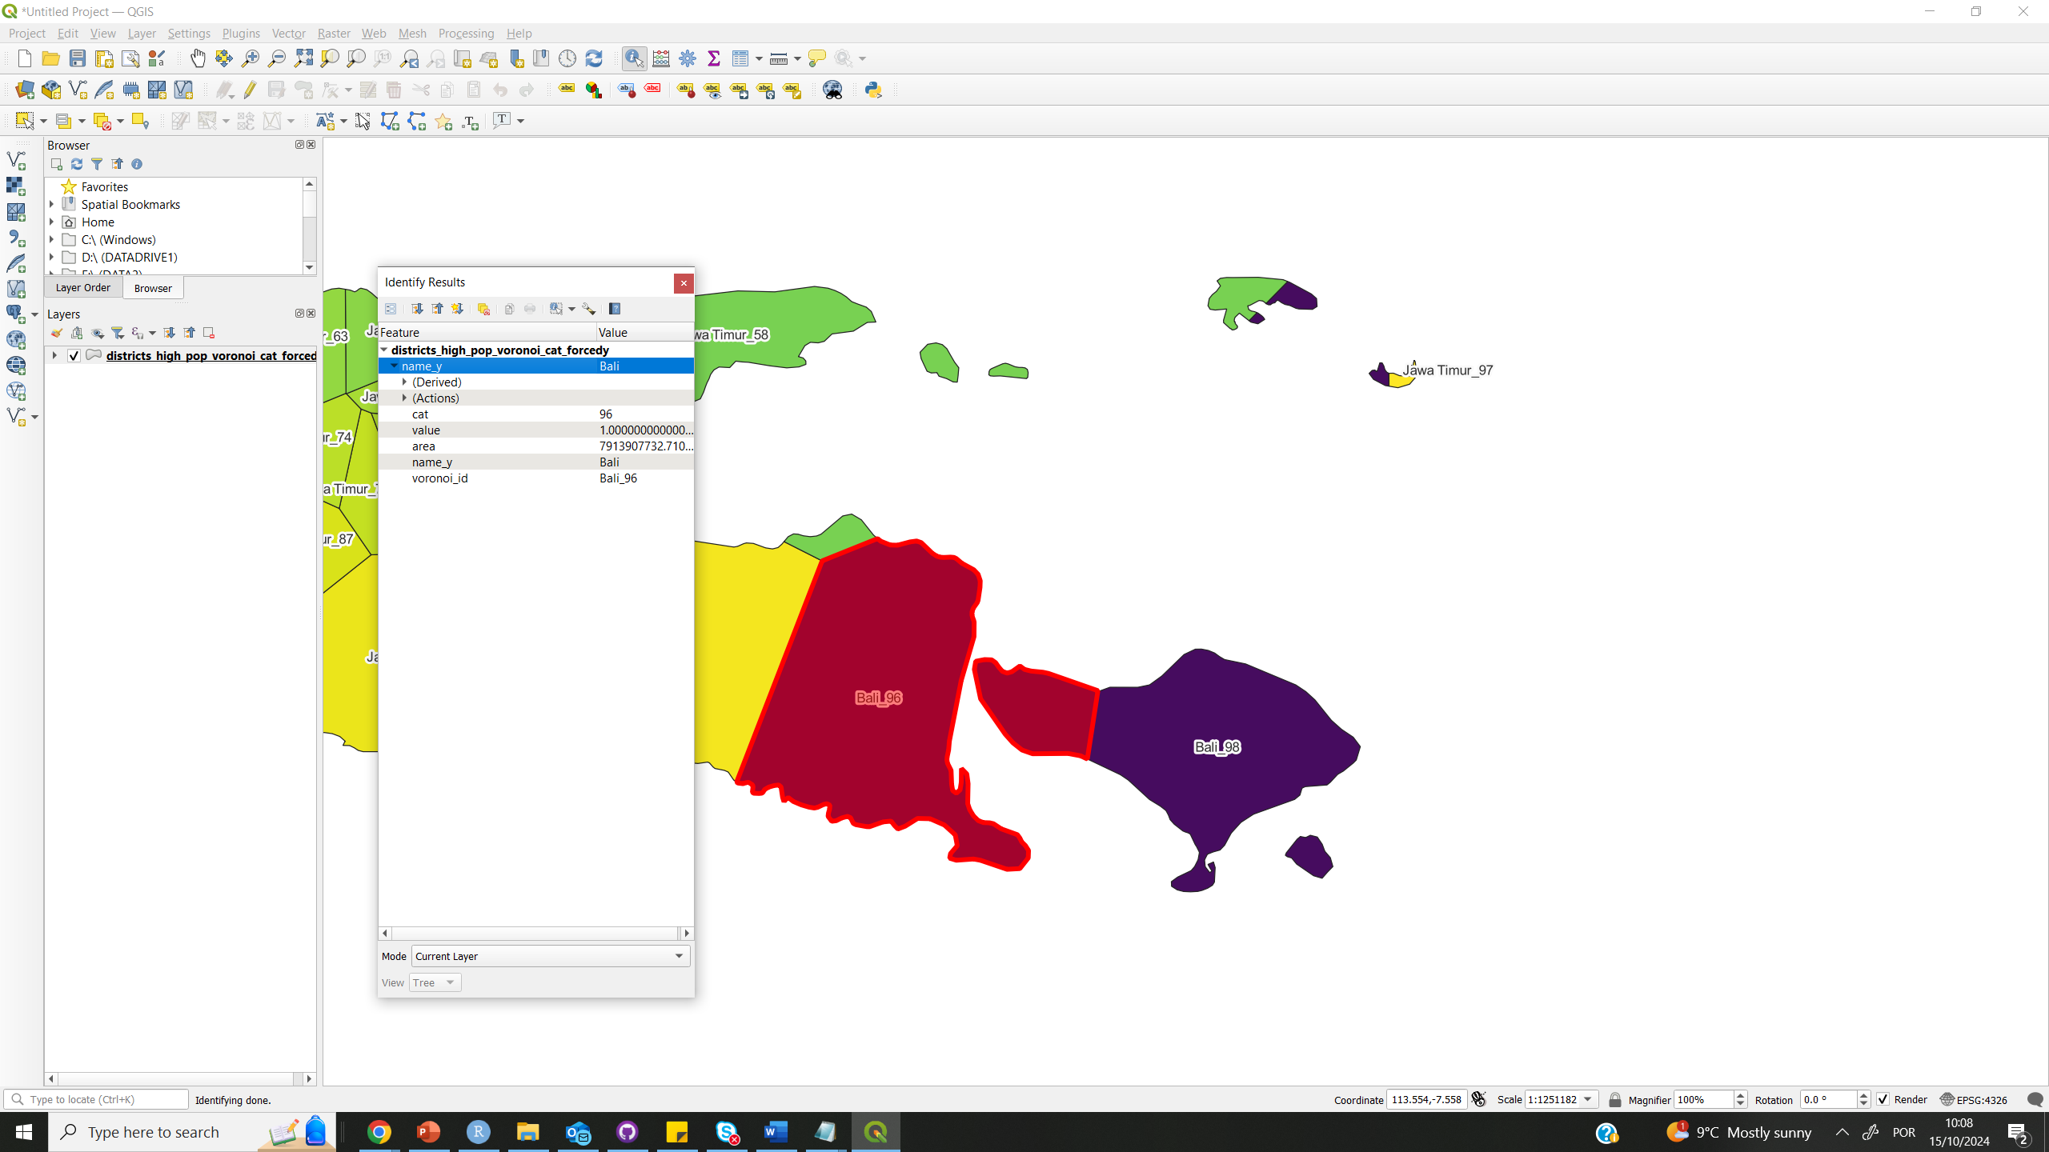

Slide 15
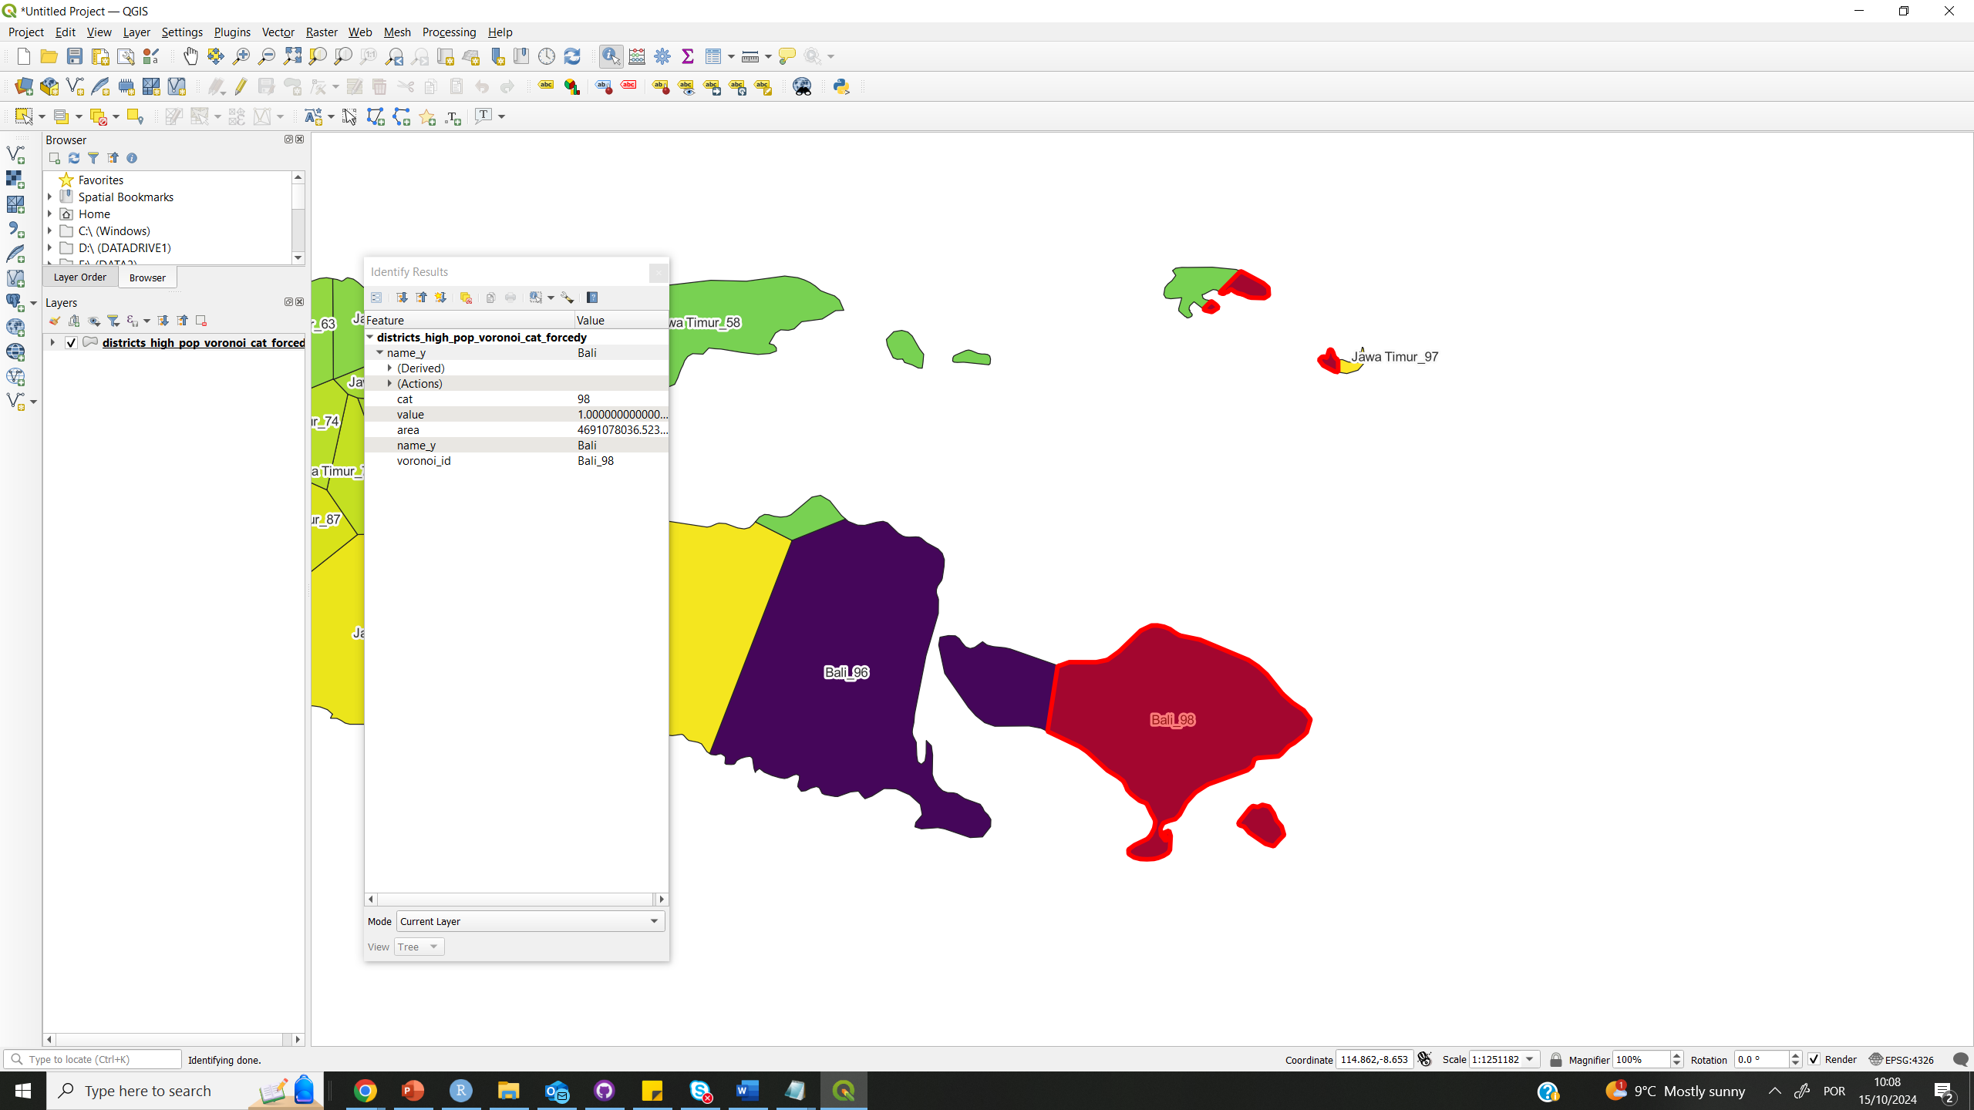

Slide 16
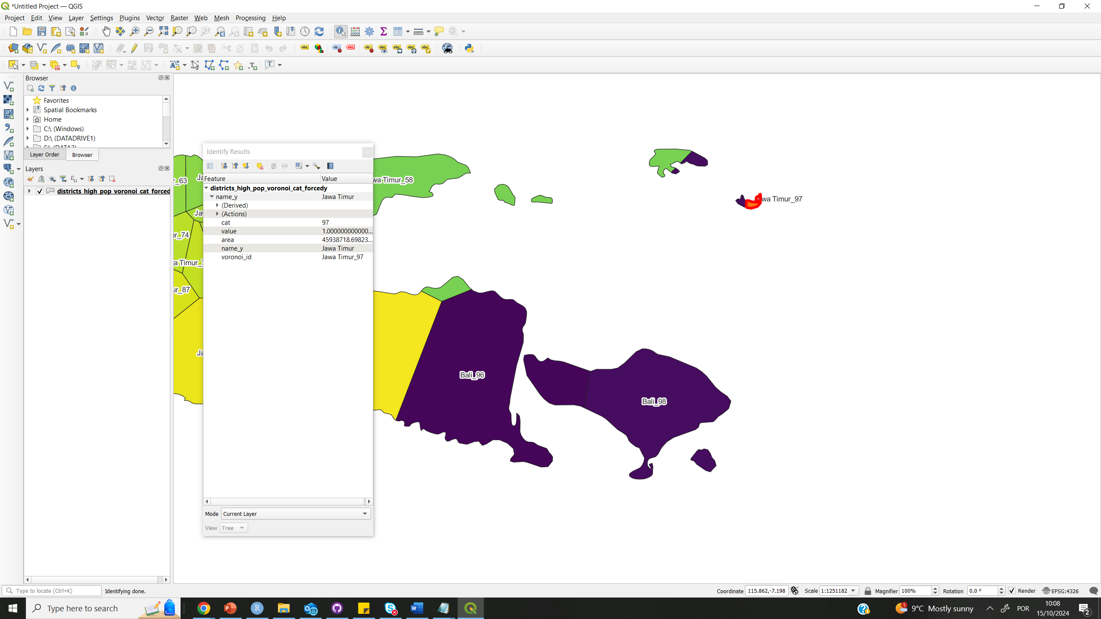

Slide 17
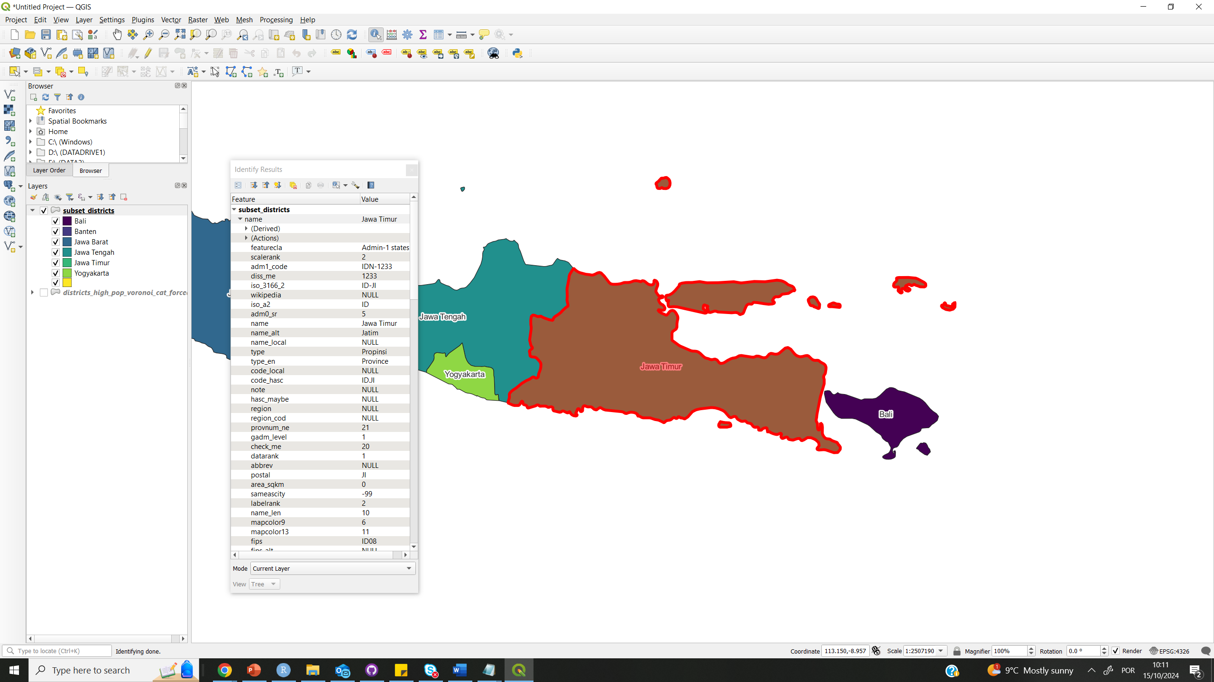

Slide 18
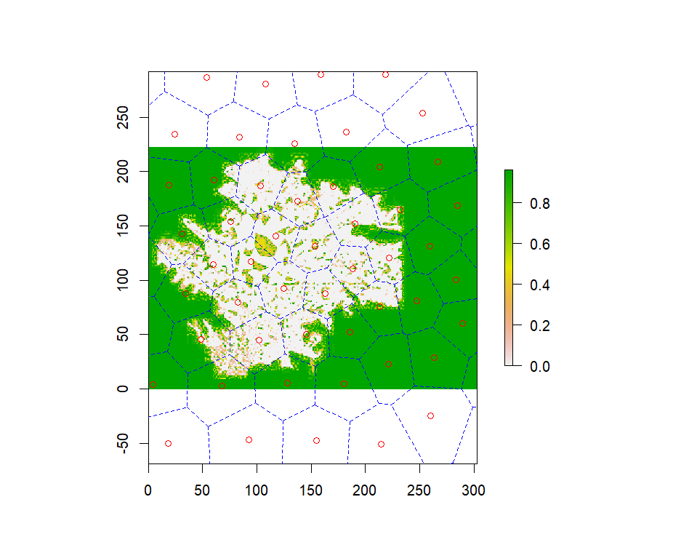
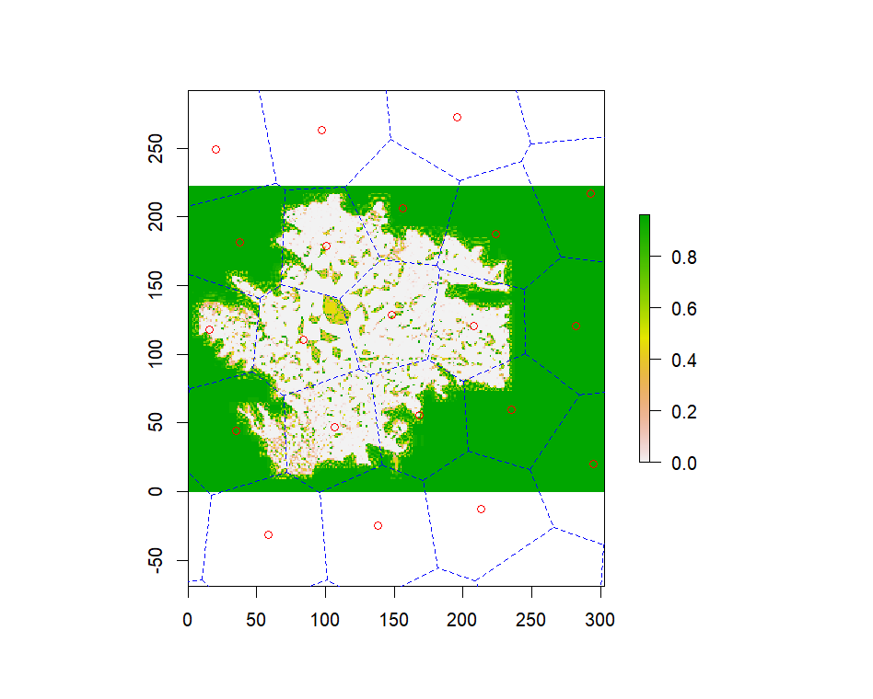
adjusted_points=sampled_pointsfor(x in 1:3){ voronoi <- deldir(adjusted_points$x, adjusted_points$y) adjusted_points=tile.centroids(tile.list(voronoi))}
adjusted_points=sampled_pointsfor(x in 1:22){ voronoi <- deldir(adjusted_points$x, adjusted_points$y) adjusted_points=tile.centroids(tile.list(voronoi))}

Slide 19
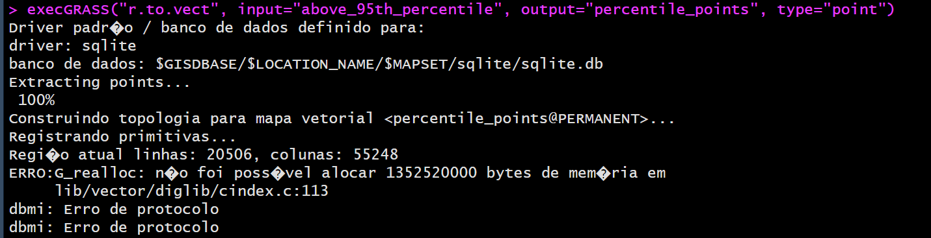
Voronoi issues – pixel to point memory allocation

Slide 20
# g.region versus r.mask
g.region adjusts the computational region to match the extent and resolution of pop, impacting where calculations occur.
r.mask establishes a mask that restricts operations to the non-null values of pop, affecting how calculations are performed within the defined region.
Outcome:
Using g.region impacts which area is considered for computations.
Using r.mask affects how values in that area are treated (i.e., ignoring nulls).

Slide 21
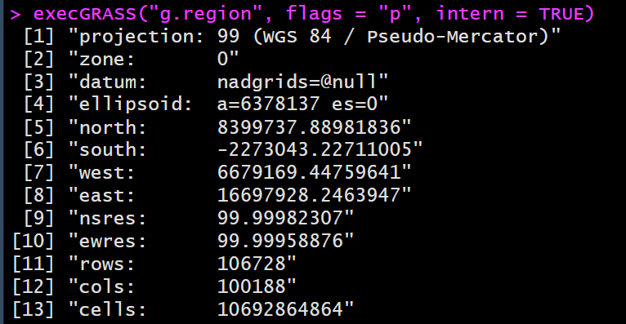
Asia region dim as 100 m

Slide 22
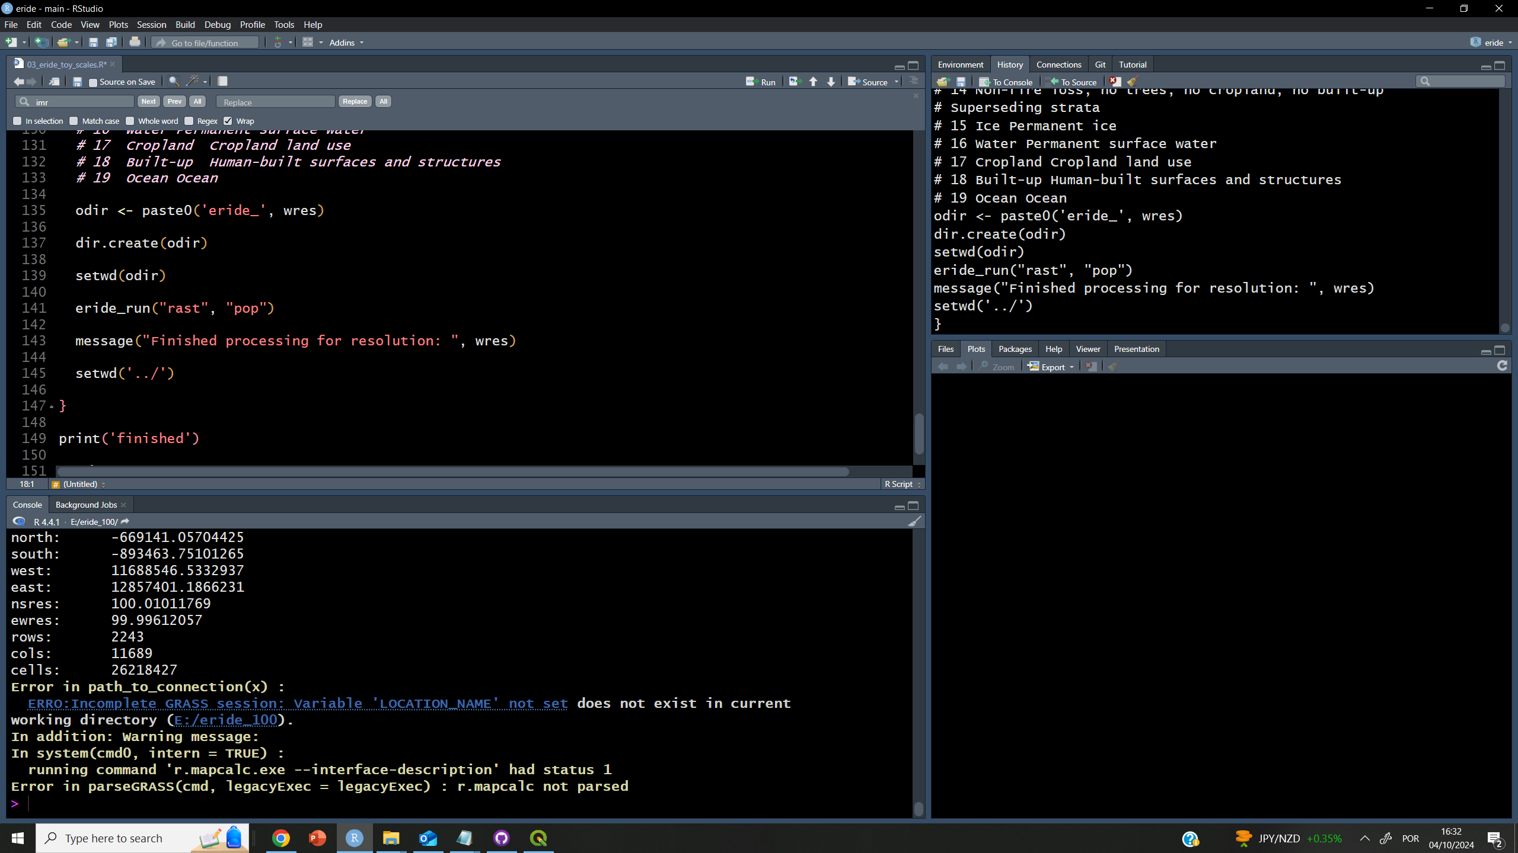
Loops break location workflow

Slide 23
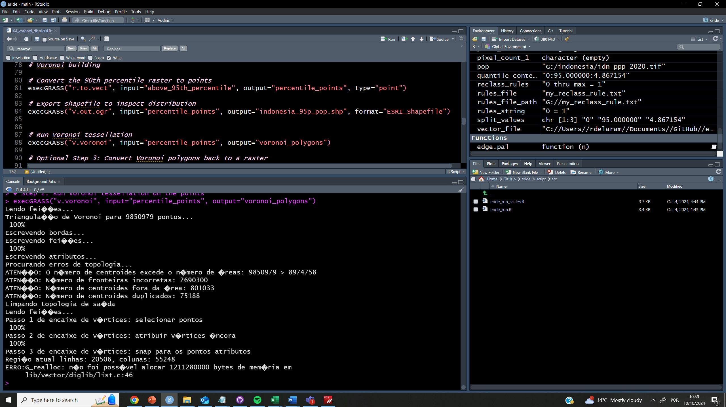
95p still too big to vectorise

Slide 24
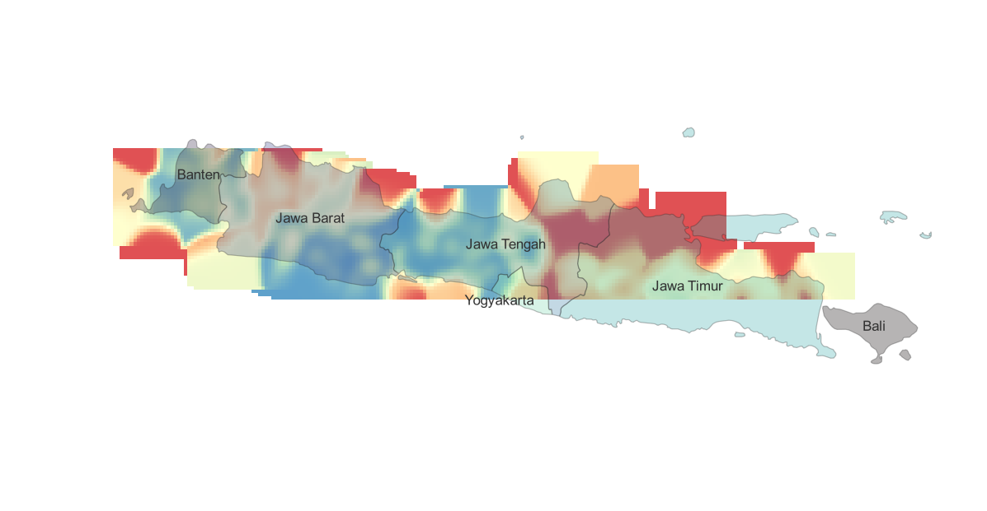

Slide 25
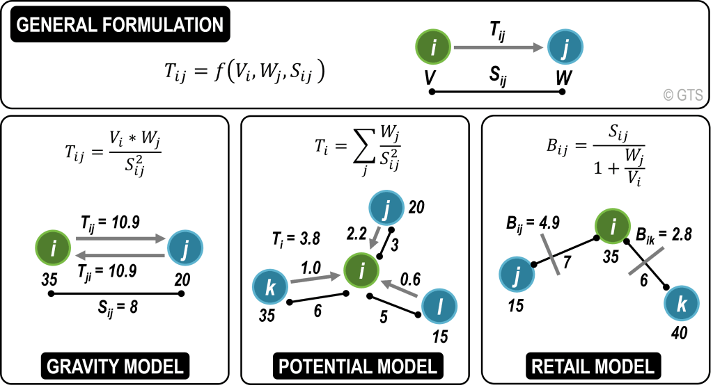
Possibilities for Pandemic potential calculation
Notes:
https://transportgeography.org/contents/methods/spatial-interactions-gravity-model/spatial-interactions-basic-models/

Slide 26
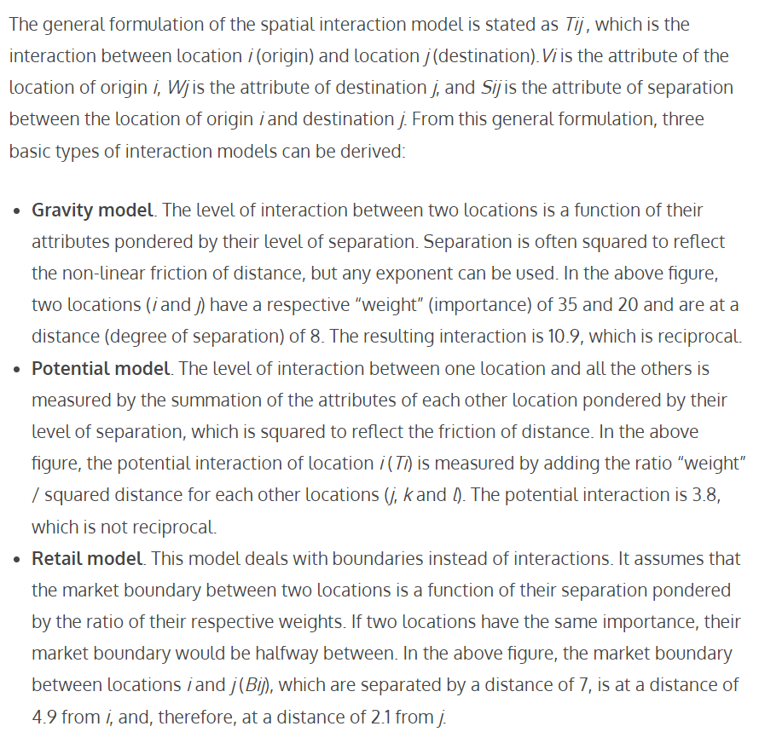

Slide 27
Is a patch-based model globally relevant?
Does a mechanistic model (based on island biogeography) compare to the global patterns of coarser, correlative models previously published?

Slide 28
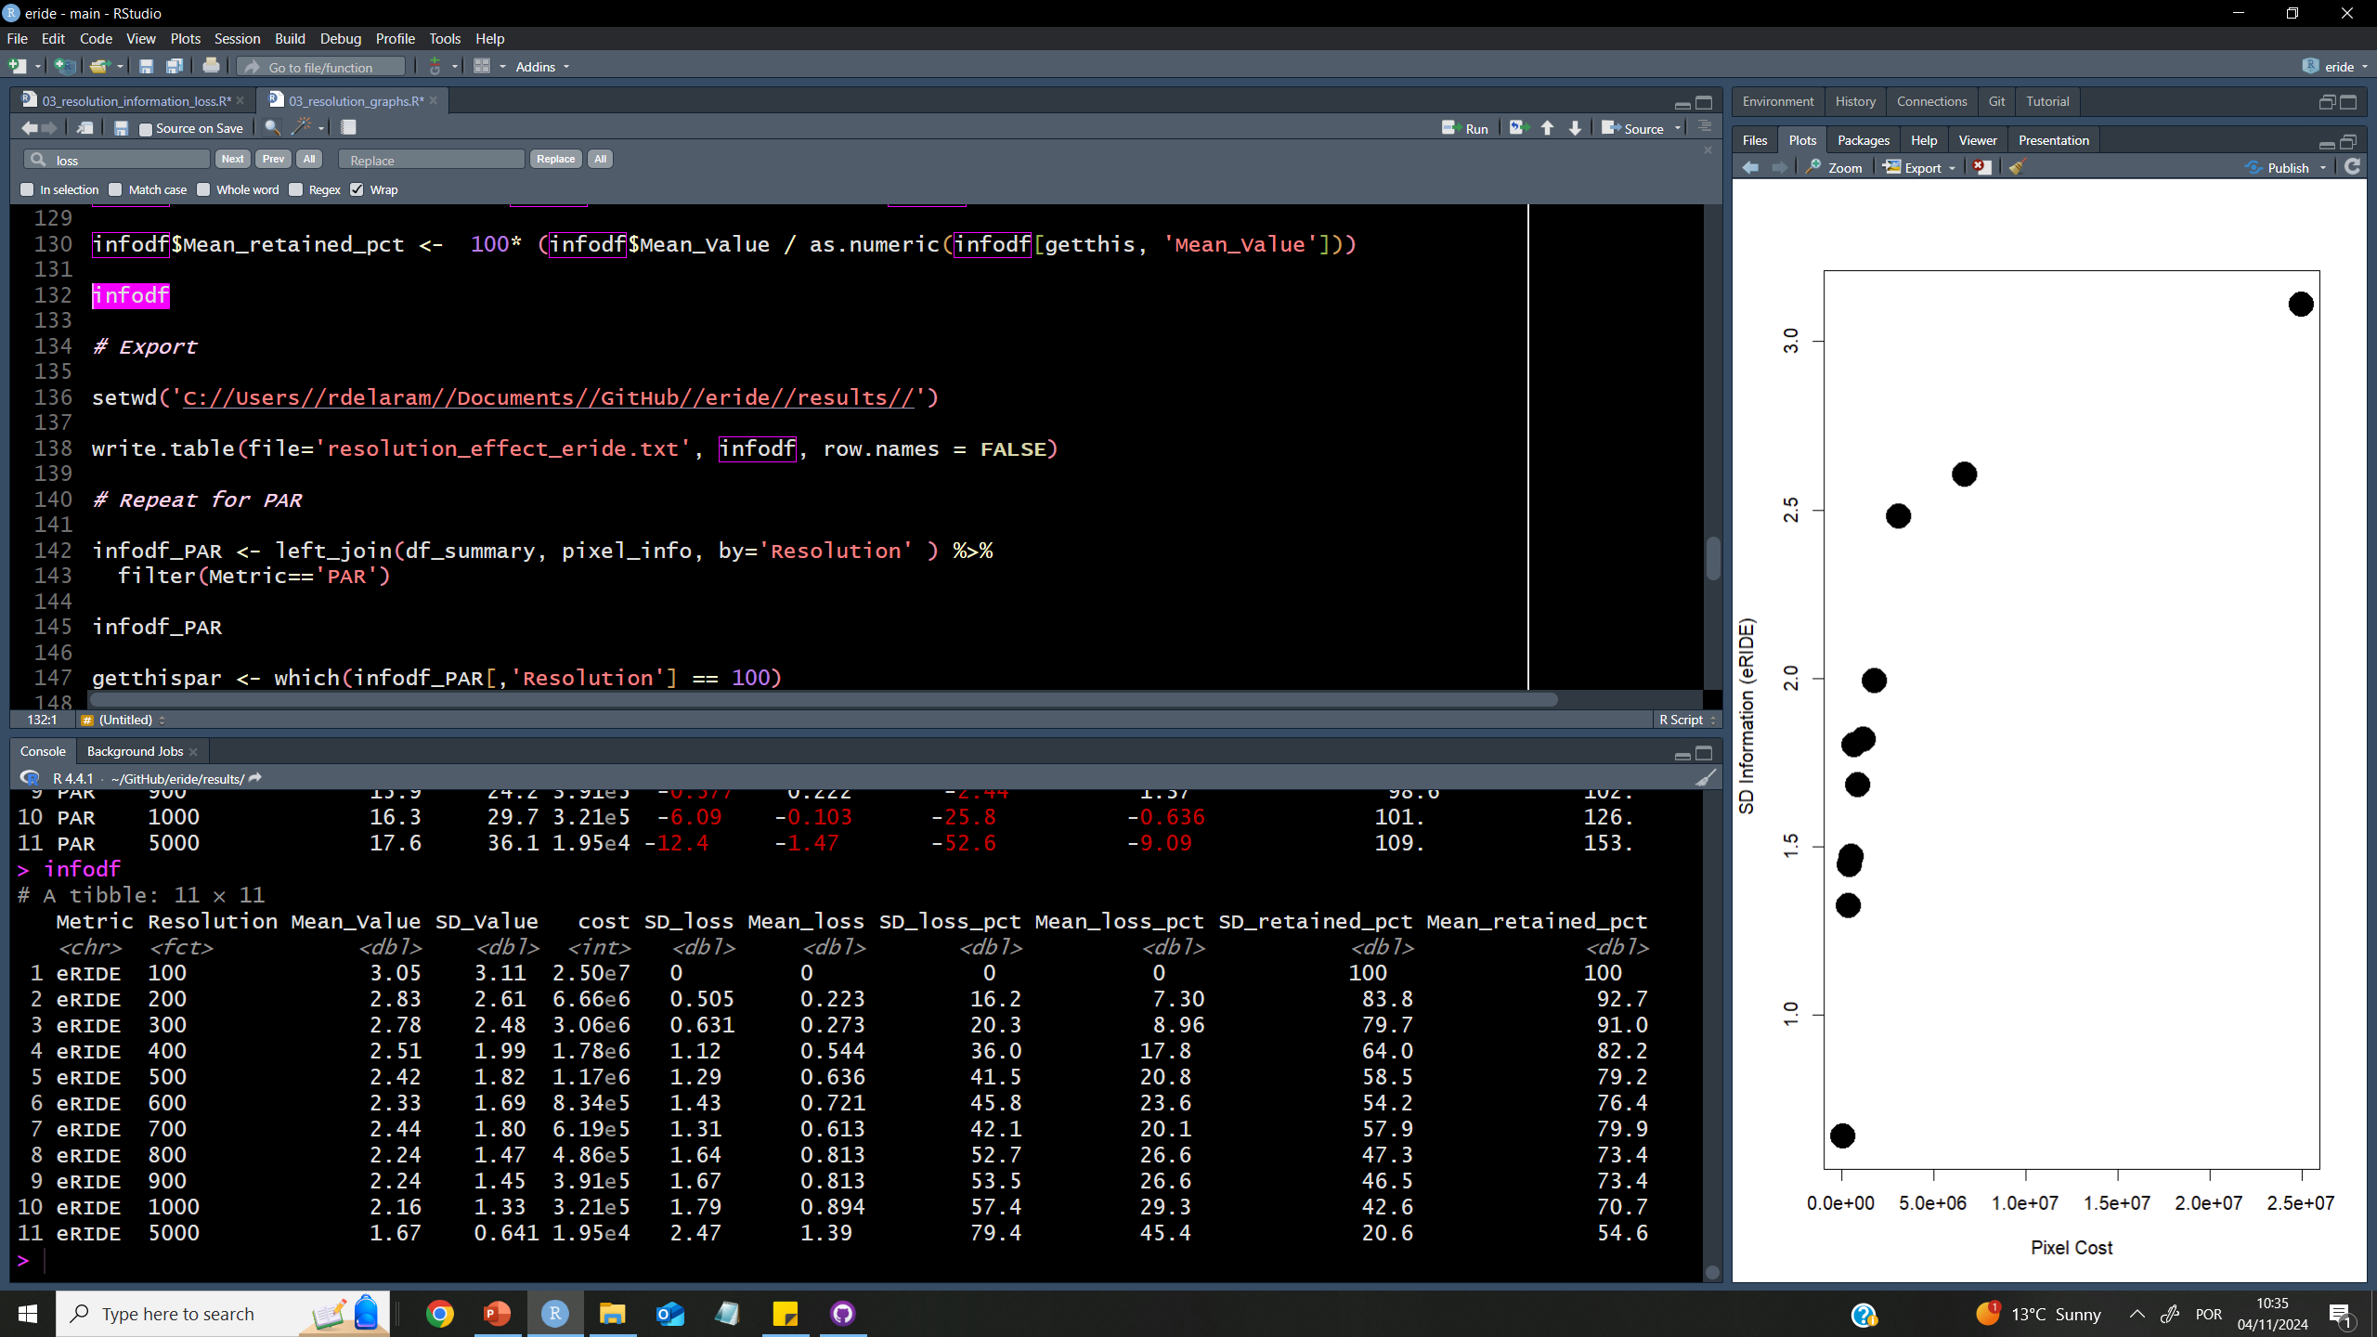

Slide 29
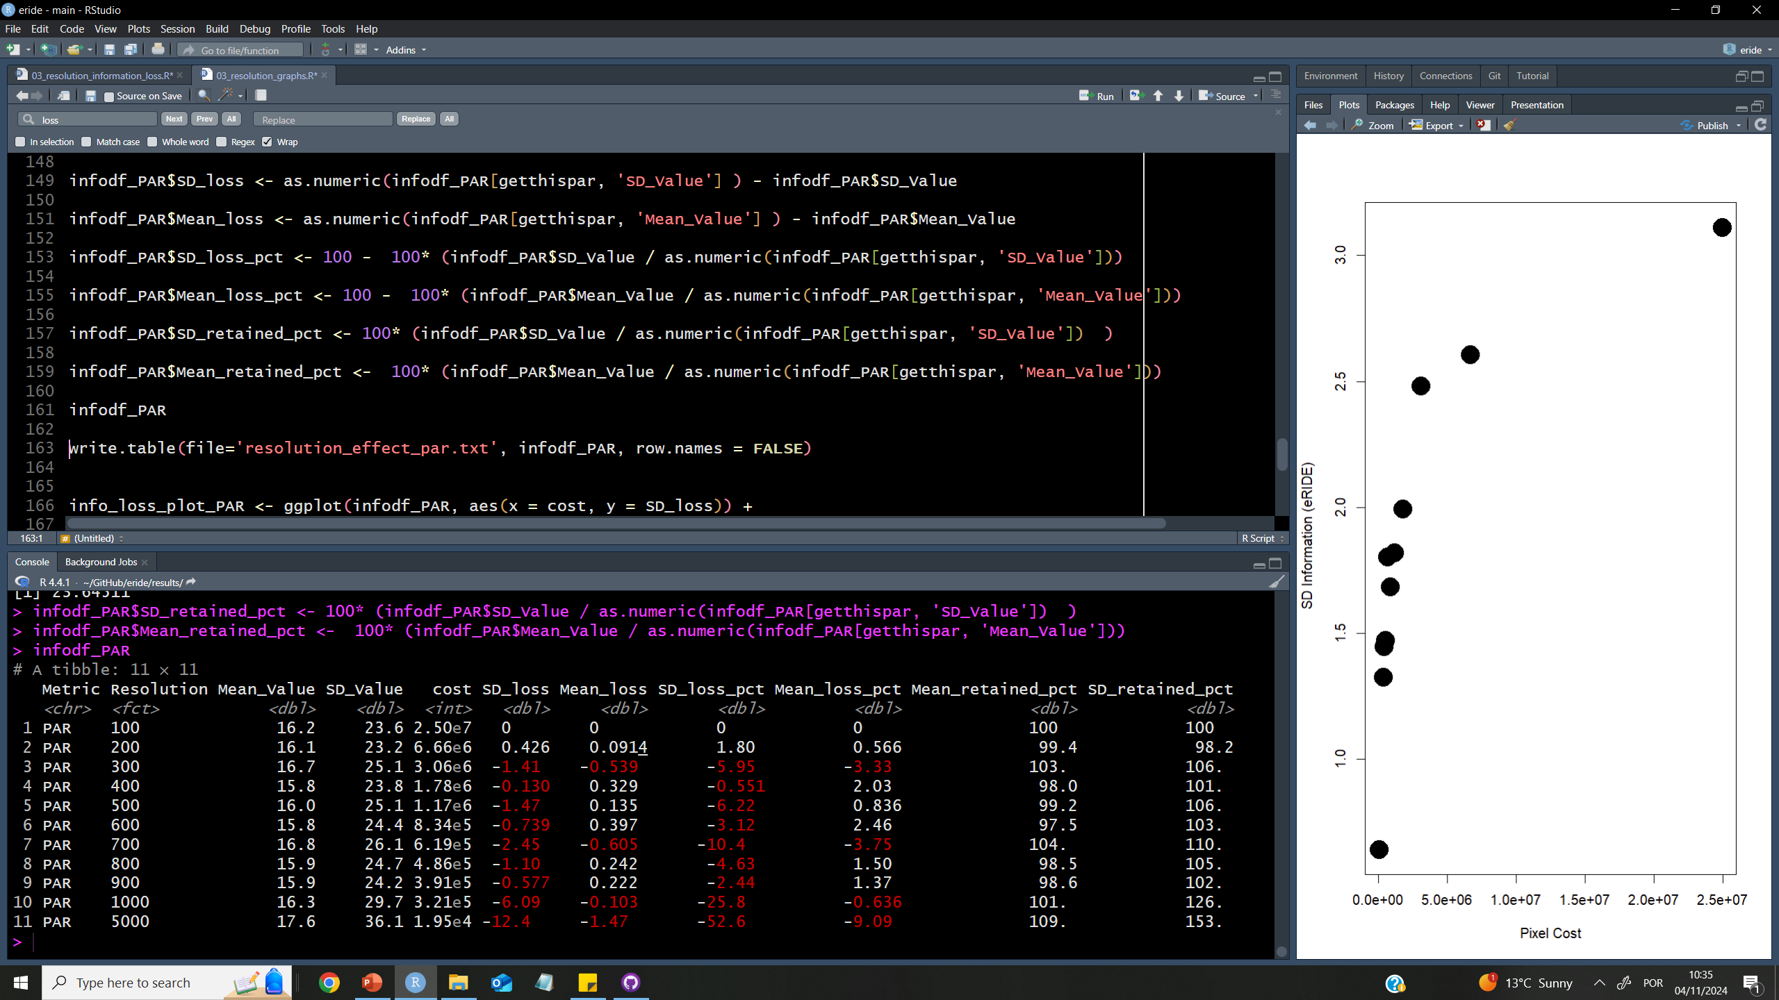

Slide 30
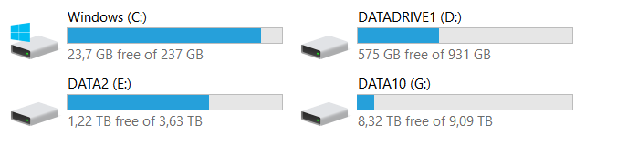
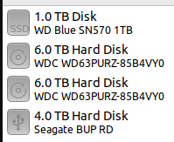
Computational power
Minimal requirements ( Massey PC 2023):
7 cores, 32 RAM, a lot of local mem
Massey PC 2024
DW PC Reunion

Slide 31
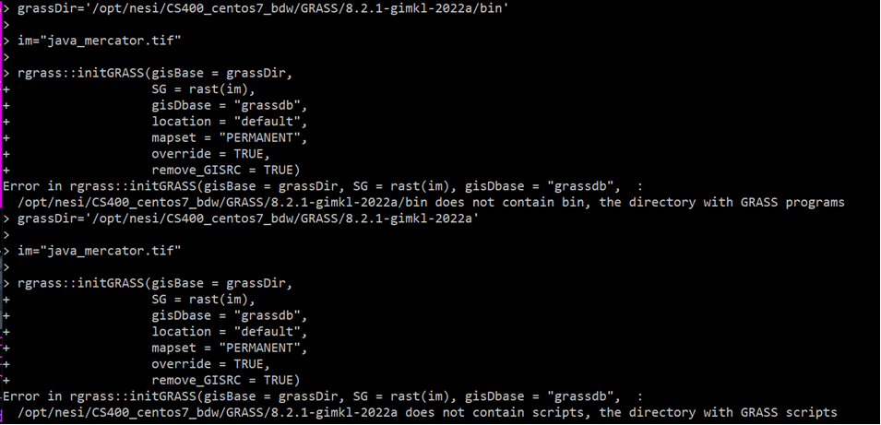
Almost there with GRASS in HPC! R update done Grass module (hidden) installed

Slide 32
To be continued..

